Slide 1
Title IX – Lessons Learned
Megan Farrell, Title IX Consult LLC
Erin Ferrara, Champlain College
Celeste Bradley, Institutional Compliance Solutions

Slide 2
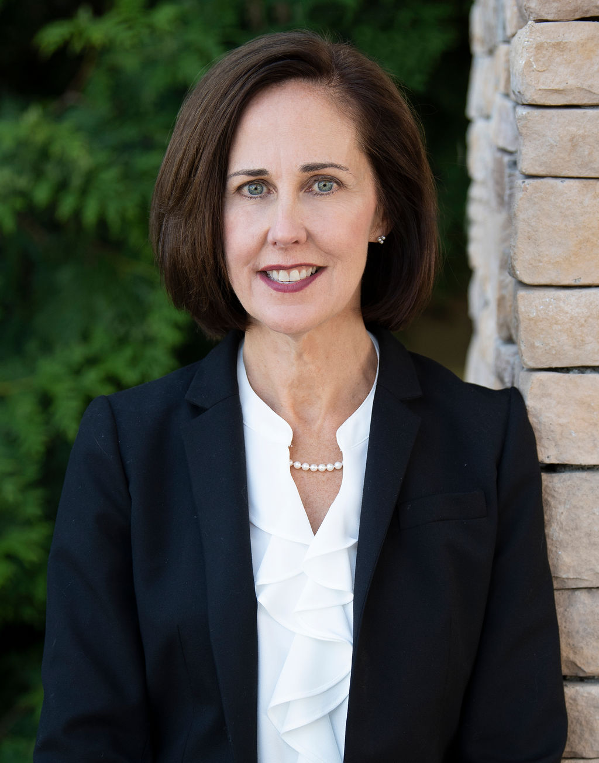
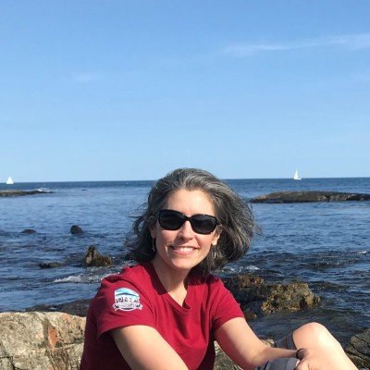
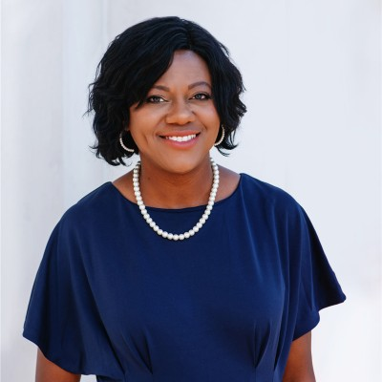
Presenters
Megan Farrell
Title IX Consult, LLC
Erin Ferrara,
Champlain College
Celeste Bradley
Institutional Compliance Solutions
Jod

Slide 3
Overview
Review of the Current 2020 Regulations
Campus Experiences
What Should Stay or Go
What Draft of New Regulations Indicate
Questions and Answers

Slide 4
Review of 2020 Regulations
Proscribed process
Limited jurisdiction
Sexual Harassment Definitions
Investigation Process
Separation of Investigator and Decision-Maker
Hearings
Grounds for Appeal

Slide 5
Part I - Regulation Specifics
Jurisdiction
Offer of Process
Definitions
Notice of Allegations

Slide 6
Which Best Practices Should Survive?
Experience Has Demonstrated
New Regulations
A reasonable limitation on jurisdiction, but . . .
Action permitted without formal complaint
A universally accepted definition of hostile environment
NOA is too much info
Jurisdiction will expand
Informal resolution will be permitted
Hostile environment definition will be expanded
NOA may not be required in all instances

Slide 7
Part II - Regulation Specifics
Investigation Process
Separation of Investigator and Decision-Maker
Timelines for Review
Sharing of Full Investigation File
Sharing of Draft and Final Investigation Report

Slide 8
Investigation
Provide party with a description of evidence and opportunity to respond
Process to adequately assess the credibility of parties/witnesses
Separate Investigator/DM/Coordinator

Slide 9
Formal Title IX Grievance Process for Investigations
Investigate
Opportunity to inspect and review evidence related to the allegations and provide written response – 10 days
Investigative Report
Opportunity to review final report and provide written response – 10 days
Hearing
Appeal

Slide 10
Which Best Practices Should Survive?
Experience Has Demonstrated
New Regulations
Training for all participants
Review periods are needed
Need to streamline the process
Expanded training
No determination of review periods going forward
Single Investigator model . .. For some institutions
Less Prescriptive Process

Slide 11
Part III - Regulation Specifics
Advisor Role
Hearing
Appeal

Slide 12
Which Best Practices Should Survive?
Experience Has Demonstrated
New Regulations
Advisors add the formality of the process and may interfere
Hearings have had negative impact, particularly on smaller institutions
Adding other grounds for appeal unusual
Advisor will continue in the process
Hearings may be voluntary
Fairly consistent grounds for appeal

Slide 13
Impact of Hearing Requirement
Negative impact on willingness of Complainants to file
Student experience of hearings have been negative, and when shared broadly, lowered:
Number of complainants received
Willingness to proceed formally (and potentially informally)
Large financial burden on the Title IX Office
Counter to institution culture

Slide 14
Questions?

