Slide 1



Slide 2

VSCS Strategic Action Plan
2024-2029 Strategic Planning Process
CCV 2018 Strategic Plan

Slide 3
 | CCV Strategic Priority | VSCS Strategic Priority
Pillar I Create Pathways and Programs for Academic and Career Success | Priority 1 Offer academic programs with clear, streamlined pathways that are aligned with requirements for further education and employment. | Accessibility Relevance
 | Priority 2 Increase occupational credentials with learning outcomes that are clearly aligned with Vermont employer and industry sector needs. | Relevance
 | Priority 3 Expand constructs for innovative and flexible program delivery. | Accessibility

Slide 4
 | CCV Strategic Priority | VSCS Strategic Priority
Pillar II Cultivate Teaching and Learning Excellence | Priority 4 Expand and promote the use of data-informed, high-impact teaching practices. | Quality
 | Priority 5 Develop an integrated system of student services that supports academic achievement, career preparation, and professional success. | Accessibility Affordability

Slide 5
 | CCV Strategic Priority | VSCS Strategic Priority
Pillar III Engage the Community and Cultivate Partnerships | Priority 6 Foster responsive partnerships with a range of stakeholders including industry partners, government, education, community, and alumni. | Relevance
 | Priority 7 Raise visibility and increase awareness of the College’s quality programs, strong value, and vital role in Vermont. | Relevance

Slide 6
 | CCV Strategic Priority | VSCS Strategic Priority
Pillar IV Increase Organizational Capacity and Sustainability | Priority 8 Recruit, hire, and retain diverse and exceptional staff and faculty. | Quality
 | Priority 9 Ensure the College’s processes, design, and infrastructure meet the evolving needs of faculty, staff, students, and community in support of an innovative learning environment. | Financial Stability Affordability

Slide 7

Affordability
Open Educational Resources (OER)
  OER/No/Low Cost Designation
  Syllabus Statement
  First Day Readiness Campaign

Slide 8

Affordability
Life Gap Grants
Resource Access Manager
Student Resource Centers
Single Parent Program
Working Parent Program
Student: Virginia Litchfield

Slide 9
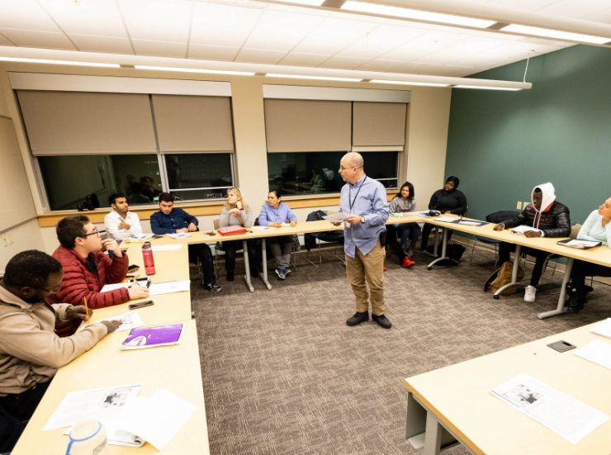

Accessibility
Redefining College Learning: Two-Way Street

Slide 10
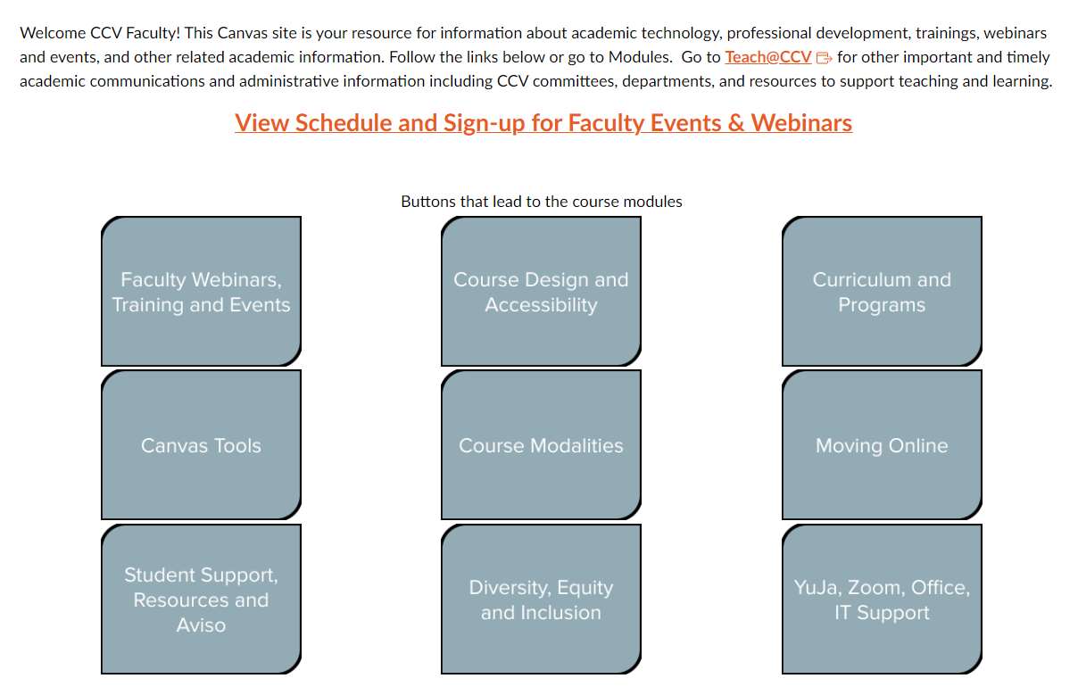
Quality
AY 2022-23 Faculty Professional Development
34 events
601 attendees
250 unique participants
96% satisfaction rate
Significant knowledge boost (+2 on 1-7 Likert scale)

Slide 11






Relevance
CCV’s Network of Strategic Partners

Slide 12
CCV to VTSU Pathway:
Creating a vital pipeline to critical occupations

Slide 14
CCV 2024-2029 Strategic Planning
July 2023
Strategic planning commenced
Oct. – Nov. 2023
SWOT sessions (internal scan)
Feb. 2024
Draft strategic priorities
April 2024
Revise and finalize plan
July – Sept 2023
Environmental Scan
March 2024
Input from PC, BOT, CCV community
September 2024
2024-2029 plan launch

Slide 15

Questions?

